Slide 1

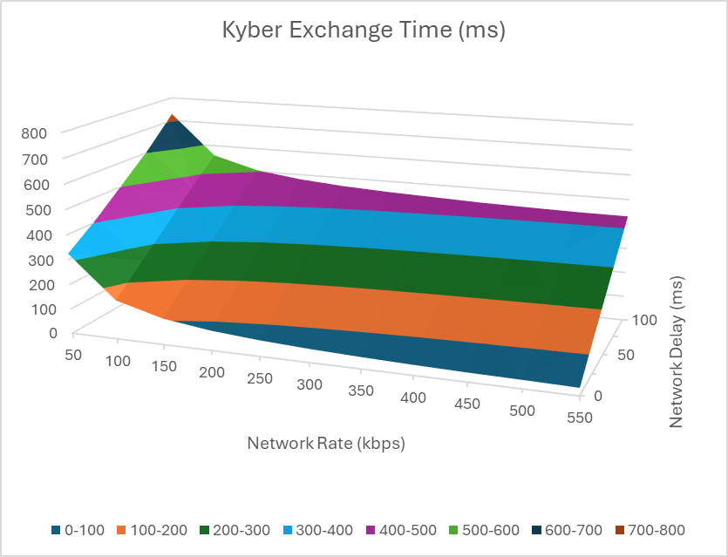
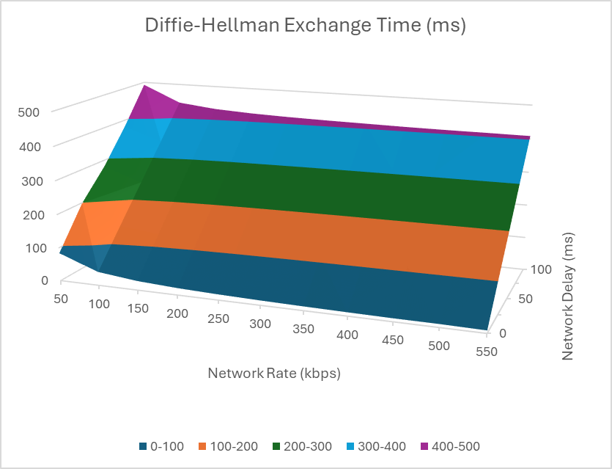

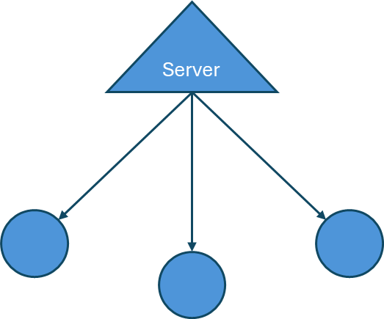
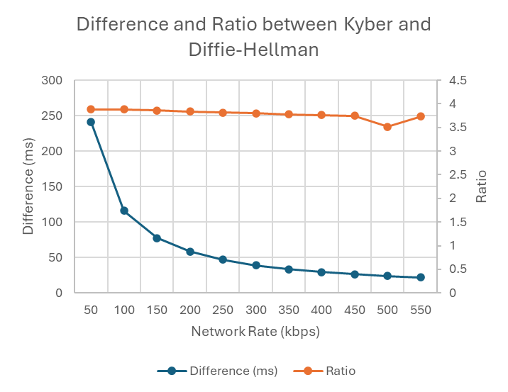
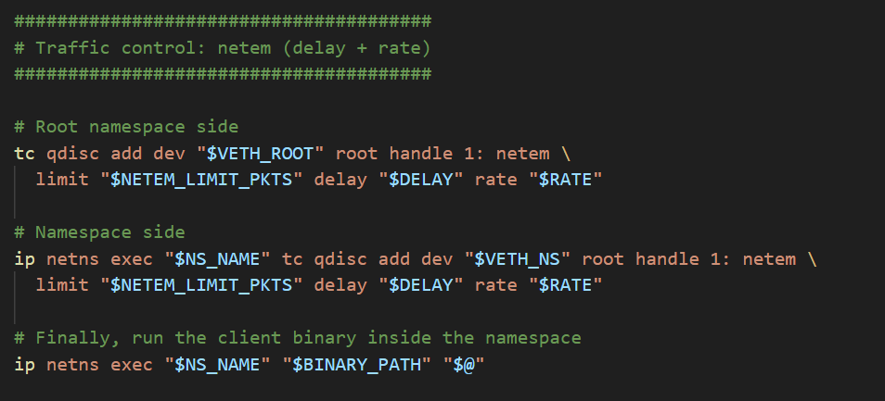
The Cost of the Quantum Transition
ECE 4301 Final Project Joshua Deckman, Jack Pearson
The Goal
Kyber is a PQC approach to asymmetric encryption
Goal: benchmark Kyber and ECC Diffie-Hellman
Anticipation: Kyber is heavier
Simulate on Raspberry Pi 5
Key Exchange Times
Inversely proportional to network rate
Directly proportional to delay (latency)
Vs.
ECC Diffie-Hellman
One Executable, Two Modes
Client/Server Topology
The client times key exchanges
Difference and Ratio Comparison
Radio mostly independent from rate
Approximately 3.8x more processing for Kyber
At 550 kbps, the difference is about 22 ms.
Network Namespace
Wraps client executable
Network parameters (such as bitrate) can be regulated
For testing, parameters were swept
For defense against quantum attacks, 22 ms is probably worth it.

